Slide 1




Learning Important Features Through Propagating Activation Differences
Avanti Shrikumar, Peyton Greenside, Anshul Kundaje
Peyton
Anshul
1
Notes:
Hi, I’m Avanti, I’m a PhD Student at Stanford, and I’m going to talk about methods we have developed to make deep learning models more interpretable.

Slide 2
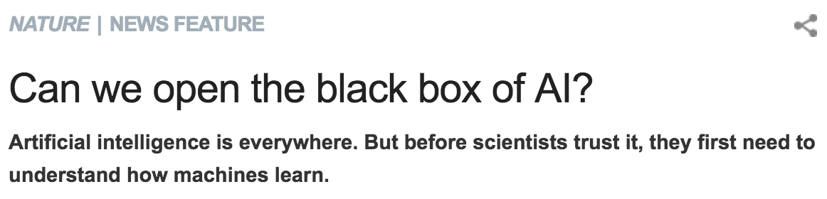
With great power comes really poor interpretability…
Deep
Learning
Interpretable Deep Learning
Power
Traditional machine learning
Classical statistics
Interpretability
2
Notes:
As methods to learn patterns from data become more complex, they become harder to interpret. Deep learning represents the latest in this trend; it gives state-of-the-art results in several areas of machine learning, but its uninterpretable “black box” nature is a major problem. Say you train a model to predict which DNA mutations cause a disease. If your model performs well, it has likely discovered patterns that we ourselves would like to understand, which is not so easy if the model is a black box. The goal of our research is the make deep learning more interpretable so that we can have our powerful models and also gain insight into why they work.

Slide 3
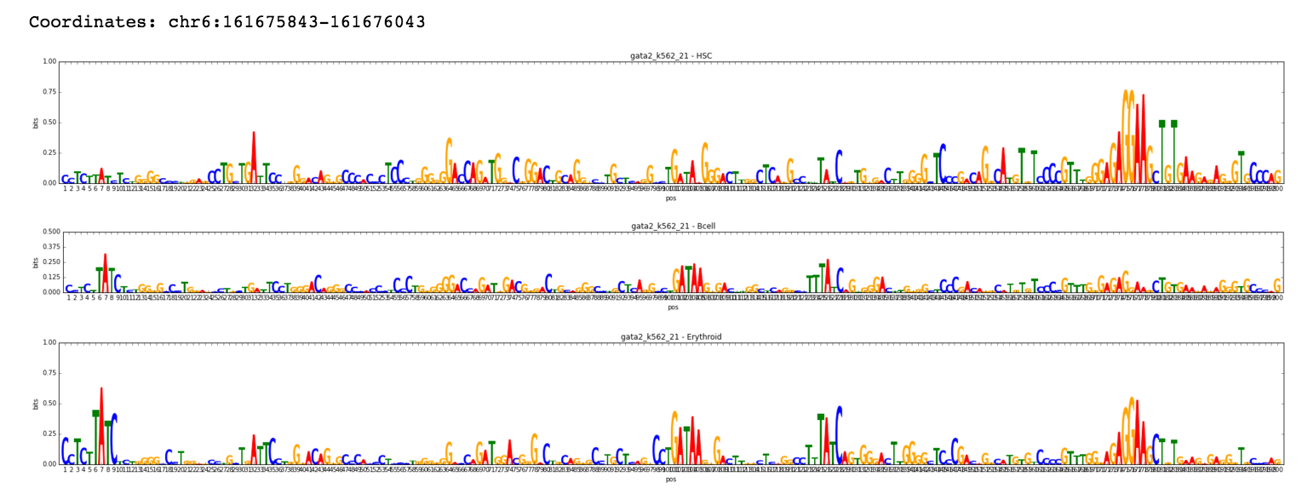
What do we mean by interpretability?
Our goal: example-specific explanations
For a given example and output, give an importance score to individual parts of the input
3
Notes:
First, I’ll clarify what we mean by interpretability since there are many notions of it. In this work, we are concerned with example-specific explanations. That is, for a given example and output, our goal is to assign importance scores to individual parts of the input. So, for instance, if our input is a DNA sequence and the output is whether or not a certain protein is binding to that sequence, our goal is to highlight the positions in the sequence that are most relevant for predicting whether or not the protein will bind.

Slide 4


How can we find the important parts of the input for a given prediction?
Idea 1: perturbation
Examples
Zeiler & Fergus, 2013
LIME (Ribeiro et al., 2016)
Zintgraf et al., 2017
Output
…
…
Drawbacks
1) Computational efficiency - requires one forward prop for each perturbation
2) Saturation
…
…
Yellow = inputs
4
Notes:
Let’s talk about approaches that one might take to obtain these importance scores. Perhaps the most intuitive are perturbation-based approaches. These approaches work by making a perturbation to the input and observing the change in the output. This is repeated for different perturbations of the input, each time observing the change in the output. There are several approaches that fall into this family, one of the earliest being by Zeiler & Fergus in 2013 where they had a sliding window occlude different parts of the image and looked at the change in the output. LIME also falls into this category, where a linear model is built to approximate the local behaviour of the network using data gathered from making input perturbations. A common drawback to perturbation-based approaches is computational efficiency; every time you make a perturbation, you have to recompute the outputs using a forward propagation. Another more subtle issue is one of saturation, and I’ll talk more about it in the next slide.

Slide 5
Saturation problem illustrated
y
=1
1
y
1
2
i₁
i₂
0
=1
=1
i₁ + i₂
0
Avoiding saturation means perturbing combinations of inputs → increased computational cost
5
Notes:
Consider the output y which is a function of the inputs i1 and i2. When i1 + i2 is greater than 1, the output y saturates to 1. Consider the point where i1=1 and i2=1. If at this point I perturb i1 from 1 to 0, I won’t observe a change in the output, because at this point the output y is locally insensitive to the inputs. This can give me the misleading impression that neither i1 nor i2 is relevant to the output y. To avoid this saturation effect, I’d have to perturb combinations of inputs which in turn increases computational cost.

Slide 6
How can we find the important parts of the input for a given prediction?
Idea 2: backpropagate importance
Output
Examples:
Gradients (Simonyan et al.)
Deconvolutional Networks (Zeiler & Fergus)
Guided Backpropagation (Springenberg et al.)
Layerwise Relevance Propagation (Bach et al.)
Integrated Gradients (Sundararajan et al.)
DeepLIFT (Learning Important FeaTures)
https://github.com/kundajelab/deeplift
…
…
…
…
Yellow = inputs
6
Notes:
Another family of approaches that addresses the computational efficiency issue is what I will refer to as backpropagation-based approaches. In these approaches, you look at the function connecting the output to the neurons in the layer below and assign contribution scores to those neurons to represent how much they affected the output. You then repeat this process backing down through the layers until you reach the input. The reason this is efficient is that in a single backwards pass, you get importance scores for your entire input. There are a number of approaches that fall into this category and the most well-known is simply computing the gradients of the output with respect to the input, because this will give you a sense of which parts of the input the output is most sensitive to. The other approaches listed here are closely related to taking the gradients, and it turns out that they all have limitations that come from this connection to taking the gradients which essentially boil down to the fact that gradients describe only the local behaviour of a function. To address these limitations, we developed DeepLIFT, that’s Deep Learning Important Features, and you should feel free to check out our code online.

Slide 7
Saturation revisited
When (i₁ + i₂) >= 1,
gradient is 0
y
=1
1
y
i₁
=1
i₂
=1
0
1
2
i₁ + i₂
Affects:
Gradients
Deconvolutional Networks
Guided Backpropagation
Layerwise Relevance Propagation
7
Notes:
Ok, so why are gradients problematic? Let’s revisit the saturation example. Note that when i1+i2 > 1, the gradient of y with respect to i1 and i2 is zero - in fact, this is what saturation means by definition. Thus, using the gradients would once again flag neither i1 nor i2 as important. This issue also affects deconvolutional networks, guided backpropagation and layerwise relevance propagation, again for very similar reasons.

Slide 8
The DeepLIFT solution: difference from reference
Reference: i₁⁰=0 & i₂⁰=0
y
=1
y⁰=0 as (i₁⁰ + i₂⁰) = 0 (reference)
1
With (i₁ + i₂) = 2, the “difference from reference” (Δy) is +1, NOT 0
y
i₁
=1
i₂
1
=1
0
2
i₁ + i₂
Δi₁=1
Δi₂=1
C_{Δi1Δy}=0.5=C_{Δi2Δy}
See paper for detailed backpropagation rules
8
Notes:
How does DeepLIFT get around this? We rely on the concept of the difference from a “reference” activation, where the “reference” activation is the activation that the neuron has when presented with the “reference” or “neutral” input - and we’ll talk about that more in a moment. For this example, let’s assume that our inputs are mean and variance normalized so a reasonable “reference” value is 0 for for i1 and i2. Note that when i1+i2 is 0, the activation if the hidden unit is 1 due to the positive bias term. Now, when we look at the point where i1+i2 is 2, the “difference from the reference” is -1 even though the gradient locally might be 0. This is the information that we use to propagation importance even when the gradient is zero. Now, I’ll be the first to admit that choosing the reference can be tricky, but we’ve found that for genomics, using an input that reflects the average gc-content of the negative set can work fairly well, and one thing we want to explore is having different references for different types of regions that have very different GC-contents – say one reference for promoters and one for enhancers.

Slide 9
Integrated Gradients: Another reference-based approach
y
=0
1
y
i₁
=0.0
i₂
1
=0.0
0
2
i₁ + i₂
i₁ | i₂ | dy/di_{x}
0.0 | 0.0 | 1
i₁ | i₂ | dy/di_{x}
dy/di_{x} = 1
9

Slide 10
Integrated Gradients: Another reference-based approach
y
=0
1
y
i₁
=0.2
i₂
1
=0.2
0
2
i₁ + i₂
i₁ | i₂ | dy/di_{x}
0.0 | 0.0 | 1
0.2 | 0.2 | 1
i₁ | i₂ | dy/di_{x}
dy/di_{x} = 1
9

Slide 11
Integrated Gradients: Another reference-based approach
y
=0
1
y
i₁
=0.4
i₂
1
=0.4
0
2
i₁ + i₂
i₁ | i₂ | dy/di_{x}
0.0 | 0.0 | 1
0.2 | 0.2 | 1
0.4 | 0.4 | 1
i₁ | i₂ | dy/di_{x}
dy/di_{x} = 1
9

Slide 12
Integrated Gradients: Another reference-based approach
y
=0
1
y
i₁
=0.6
i₂
1
=0.6
0
2
i₁ + i₂
i₁ | i₂ | dy/di_{x}
0.0 | 0.0 | 1
0.2 | 0.2 | 1
0.4 | 0.4 | 1
i₁ | i₂ | dy/di_{x}
0.6 | 0.6 | 0
dy/di_{x} = 0
9

Slide 13
Integrated Gradients: Another reference-based approach
y
=0
1
y
i₁
=0.8
i₂
1
=0.8
0
2
i₁ + i₂
i₁ | i₂ | dy/di_{x}
0.0 | 0.0 | 1
0.2 | 0.2 | 1
0.4 | 0.4 | 1
i₁ | i₂ | dy/di_{x}
0.6 | 0.6 | 0
0.8 | 0.8 | 0
dy/di_{x} = 0
9

Slide 14
Integrated Gradients: Another reference-based approach
y
=0
1
y
i₁
=1.0
i₂
1
=1.0
0
2
i₁ + i₂
i₁ | i₂ | dy/di_{x}
0.0 | 0.0 | 1
0.2 | 0.2 | 1
0.4 | 0.4 | 1
i₁ | i₂ | dy/di_{x}
0.6 | 0.6 | 0
0.8 | 0.8 | 0
1.0 | 1.0 | 0
Average dy/di_{x} = 0.5
(Average dy/di₁)*Δi₁ = 0.5
(Average dy/di₁)*Δi₂ = 0.5
dy/di_{x} = 0
9

Slide 15
Integrated Gradients: Another reference-based approach
Sundararajan et al.
Pros:
completely black-box
functionally equivalent networks guaranteed to give the same result
Cons:
Repeated gradient calc. adds computational overhead
Doesn’t always give an intuitive answer…
10

Slide 16
Failure-case: “min” (AND) relation
y = i₁ – h
= i₁ – max(0, i₁ – i₂)
y = min(i₁, i₂)
i₁
h = ReLU(i₁ – i₂)
= max(0, i₁-i₂)
i₂
i₁, i₂ | y
i₂ < i₁ | i₁ – (i₁-i₂) = i₂
i₂ > i₁ | i₁ – 0 = i₁
Gradient=0 for either i₁ or i₂, whichever is larger
This is true even when interpolating from (0,0) to (i₁,i₂)!
11

Slide 17
The DeepLIFT solution: consider different orders for adding positive and negative terms
i₁ = 10, i₂ = 6
y = i₁ – ReLU(i₁ – i₂)
= 10 – ReLU(4) = 6
← min(i₁=10, i₂=6)
12

Slide 18
The DeepLIFT solution: consider different orders for adding positive and negative terms
i₁ = 10, i₂ = 6
y = i₁ – ReLU(i₁ – i₂)
= 10 – ReLU(4) = 6
← min(i₁=10, i₂=6)
Standard breakdown:
4 = (10 from i₁) + (-6 from i₂)
ReLU(i₁ - i₂)
-6
+10
4
i₁ - i₂
4
i₁=10
12
i₂=6

Slide 19
The DeepLIFT solution: consider different orders for adding positive and negative terms
i₁ = 10, i₂ = 6
y = i₁ – ReLU(i₁ – i₂)
= 10 – ReLU(4) = 6
← min(i₁=10, i₂=6)
Standard breakdown: y = 6 = (10 from i₁) – [(10 from i₁) – (6 from i₂)]
= 6 from i₂
Standard breakdown:
4 = (10 from i₁) + (-6 from i₂)
ReLU(i₁ - i₂)
-6
+10
4
i₁ - i₂
4
i₁=10
12
i₂=6

Slide 20
The DeepLIFT solution: consider different orders for adding positive and negative terms
i₁ = 10, i₂ = 6
y = i₁ – ReLU(i₁ – i₂)
= 10 – ReLU(4) = 6
← min(i₁=10, i₂=6)
Standard breakdown: y = 6 = (10 from i₁) – [(10 from i₁) – (6 from i₂)] = 6 from i₂
Standard breakdown:
4 = (10 from i₁) + (-6 from i₂)
Other possible breakdown:
4 = (4 from i₁) + (0 from i₂)
ReLU(i₁ - i₂)
ReLU(i₁ - i₂)
-6
+10
4
4
0
+4
i₁ - i₂
i₁ - i₂
4
4
i₁=10
i₂=6
i₁=10
12
i₂=6

Slide 21
The DeepLIFT solution: consider different orders for adding positive and negative terms
i₁ = 10, i₂ = 6
y = i₁ – ReLU(i₁ – i₂)
= 10 – ReLU(4) = 6
← min(i₁=10, i₂=6)
Standard breakdown: y = 6 = (10 from i₁) – [(10 from i₁) – (6 from i₂)] = 6 from i₂
Standard breakdown:
4 = (10 from i₁) + (-6 from i₂)
Other possible breakdown:
4 = (4 from i₁) + (0 from i₂)
Average i₁ & i₂ contributions:
4 = (7 from i₁) + (-3 from i₂)
ReLU(i₁ - i₂)
ReLU(i₁ - i₂)
-6
+10
4
4
0
+4
i₁ - i₂
i₁ - i₂
4
4
i₁=10
i₂=6
i₁=10
12
i₂=6

Slide 22
The DeepLIFT solution: consider different orders for adding positive and negative terms
i₁ = 10, i₂ = 6
y = i₁ – ReLU(i₁ – i₂)
= 10 – ReLU(4) = 6
← min(i₁=10, i₂=6)
Standard breakdown: y = 6 = (10 from i₁) – [(10 from i₁) – (6 from i₂)] = 6 from i₂
Average over both orders: y = 6 = (10 from i₁) – [(7 from i₁) + (-3 from i₂)]
= (3 from i₁) + (3 from i₂)
Standard breakdown:
4 = (10 from i₁) + (-6 from i₂)
Other possible breakdown:
4 = (4 from i₁) + (0 from i₂)
Average i₁ & i₂ contributions:
4 = (7 from i₁) + (-3 from i₂)
ReLU(i₁ - i₂)
ReLU(i₁ - i₂)
-6
+10
4
4
0
+4
i₁ - i₂
i₁ - i₂
4
4
i₁=10
i₂=6
i₁=10
12
i₂=6

Slide 23
The DeepLIFT solution: consider different orders for adding positive and negative terms
i₁ = 10, i₂ = 6
y = i₁ – ReLU(i₁ – i₂)
= 10 – ReLU(4) = 6
← min(i₁=10, i₂=6)
Standard breakdown: y = 6 = (10 from i₁) – [(10 from i₁) – (6 from i₂)] = 6 from i₂
Average over both orders: y = 6 = (10 from i₁) – [(7 from i₁) + (-3 from i₂)]
= (3 from i₁) + (3 from i₂)
Standard breakdown:
4 = (10 from i₁) + (-6 from i₂)
Other possible breakdown:
4 = (4 from i₁) + (0 from i₂)
Average i₁ & i₂ contributions:
4 = (7 from i₁) + (-3 from i₂)
ReLU(i₁ - i₂)
ReLU(i₁ - i₂)
> 2 inputs: club pos & neg inputs into 2 “meta” terms, assign importance, distribute proportionally
-6
+10
4
4
0
+4
i₁ - i₂
i₁ - i₂
4
4
i₁=10
i₂=6
“A unified approach to interpreting model predictions” - Lundberg & Lee
i₁=10
12
i₂=6

Slide 24



Eg: morphing 8 to a 3 or a 6
original
8->3
8->6
Guided Backprop
Integrated gradients
DeepLIFT
13

Slide 25
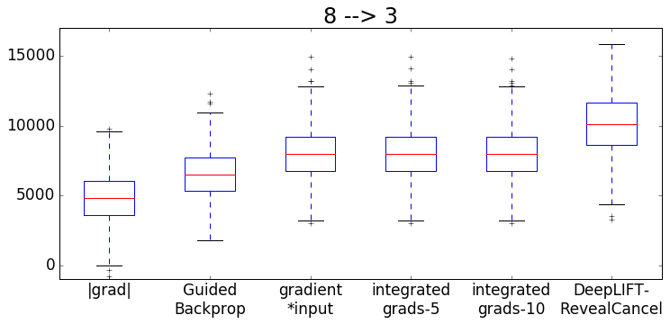
Change in log-odds after morphing
14

Slide 26
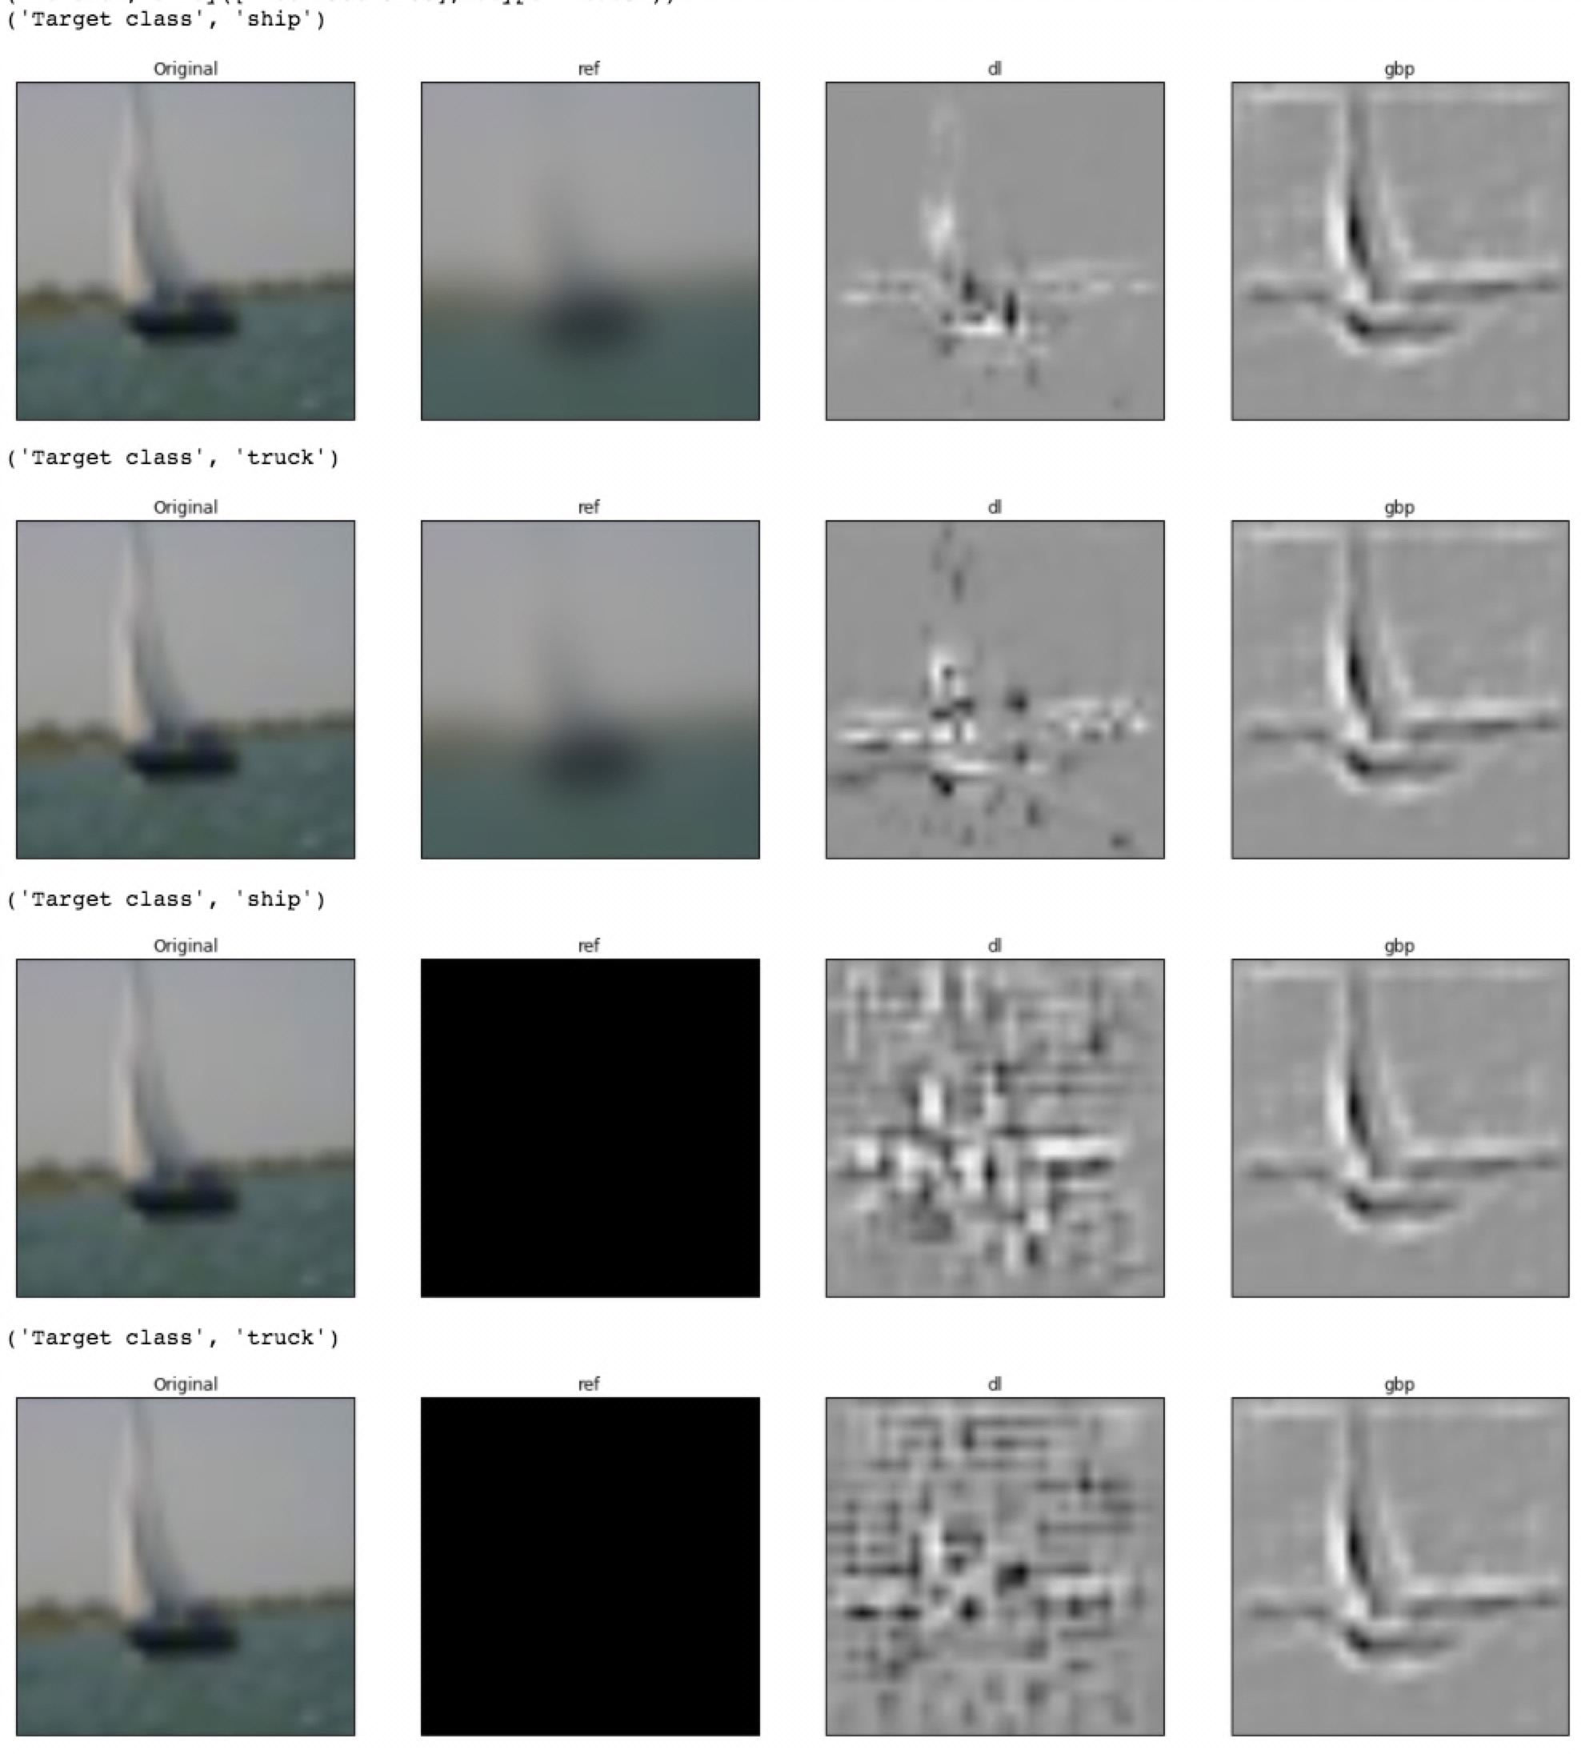
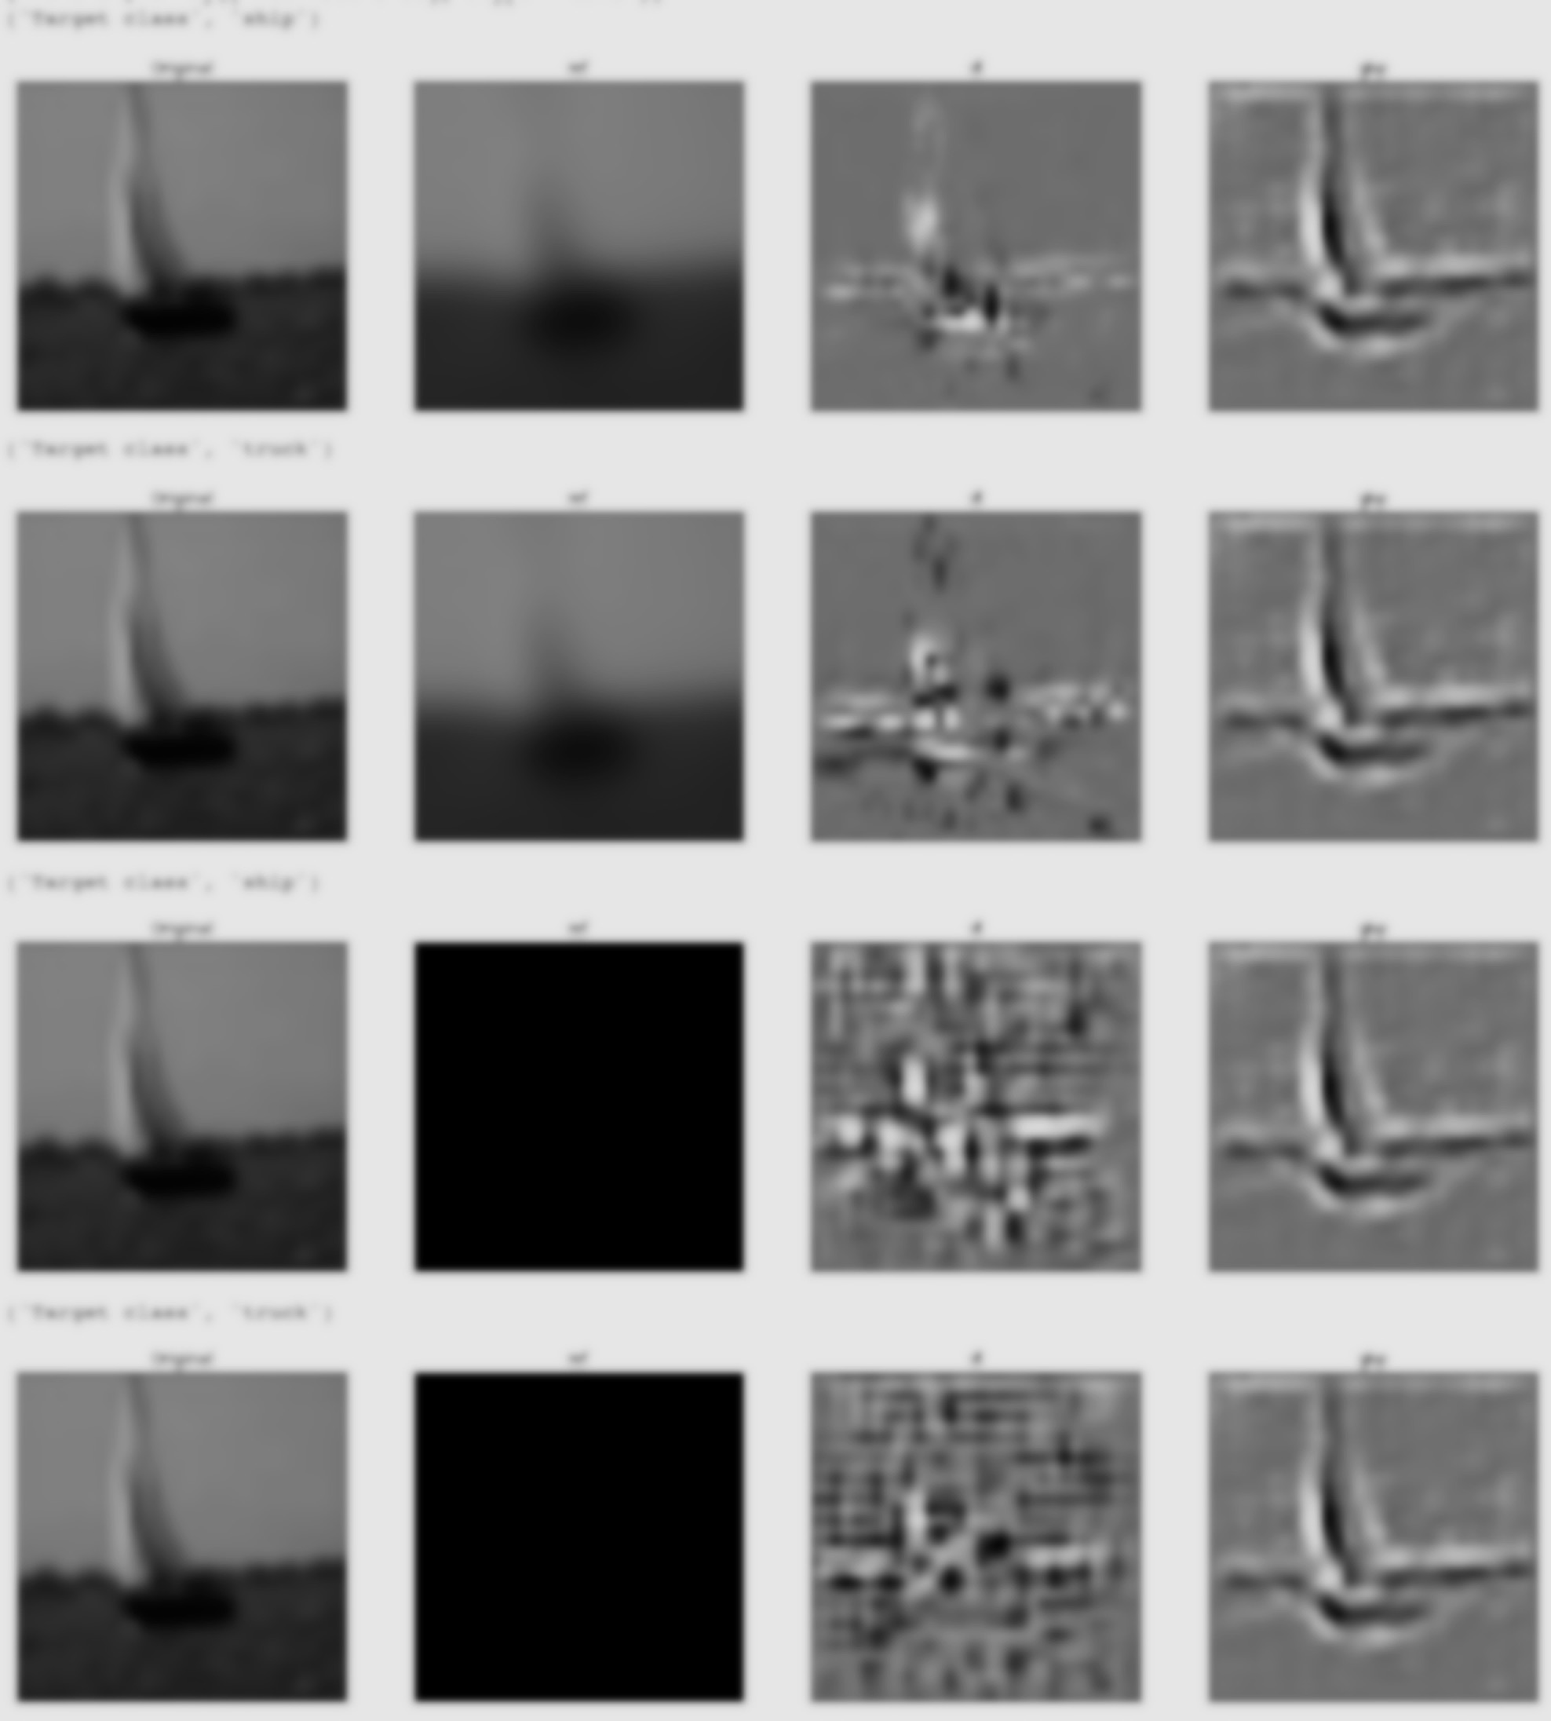
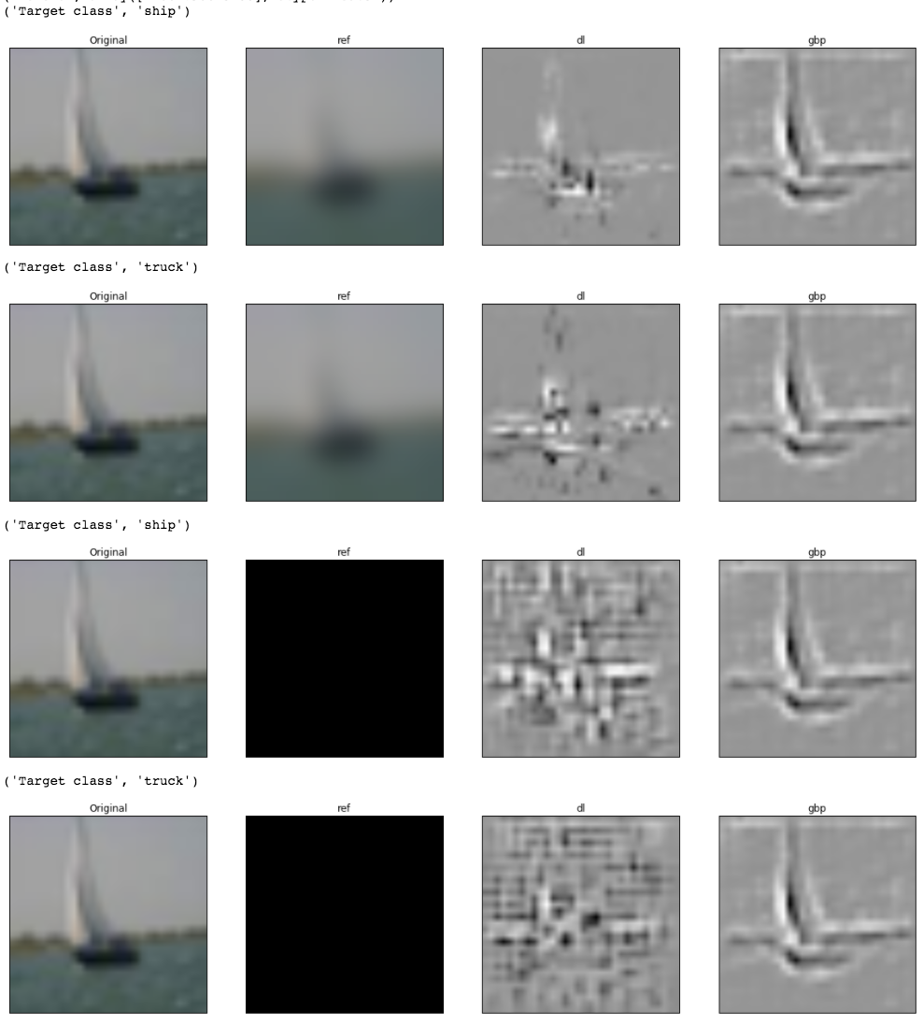
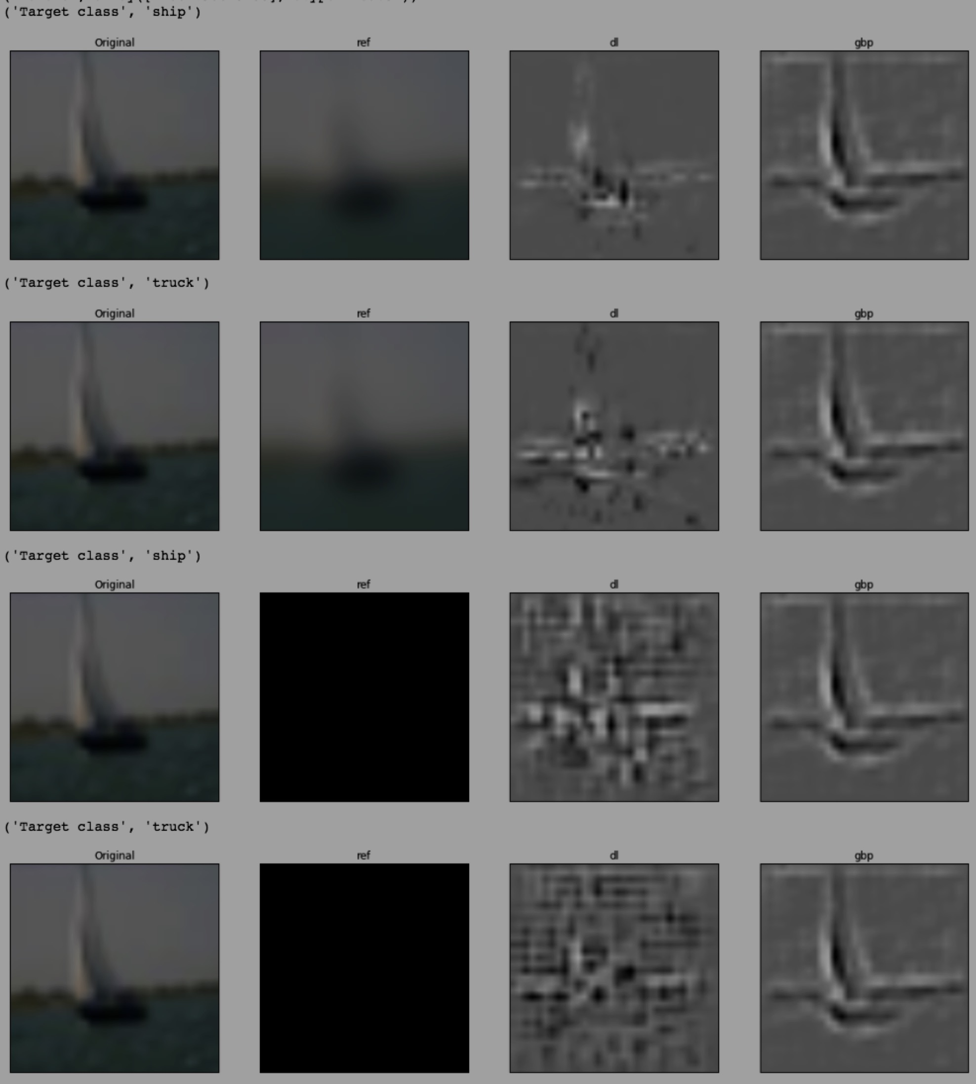
Choice of reference matters!
CIFAR10 model, class = “ship”
DeepLIFT scores
Suggestions on how to pick a reference:
MNIST: all zeros (background)
Consider using a distribution of references
E.g. multiple references generated by shuffling a genomic sequence
Original
Reference
15

Slide 27
Summary
DeepLIFT: can efficiently reveal important parts of the input for a given prediction
Computed via backpropagation: efficient
Addresses saturation & min/AND failure modes
Reference matters!
https://github.com/kundajelab/deeplift
Anshul’s keynote at comp. bio workshop! "Deep learning approaches to impute, integrate and interpret regulatory genomic data” at 10.30AM on Thursday
16
Notes:
That concludes my talk. To summarize, we’ve presented a method to reveal context-specific use of regulatory sequence with advantages over in-silico mutagenesis. We also presented the MoDISco algorithm which consolidates the importance scores into recurring motifs, and showed that it produces broader patterns compared to other approaches. What I didn’t show is that the MoDISco algorithm actually generalizes beyond DNA sequence, and discovers motifs even when applied to models trained on other kinds of genomic signal, such as DNase and MNase.

Slide 28

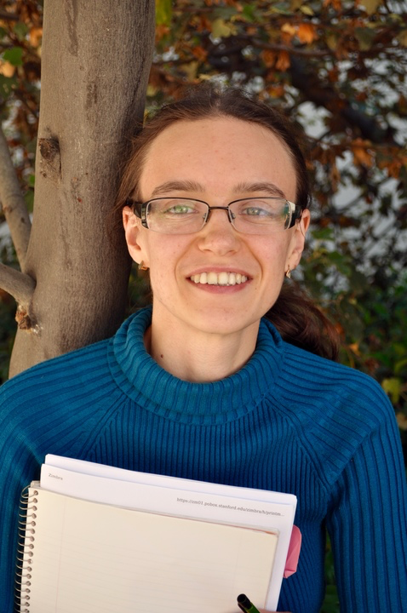
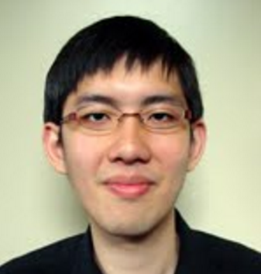


Anshul Kundaje
Peyton Greenside
Anna Shcherbina
Thank you to the Kundaje lab!
Chuan Sheng Foo
Johnny Israeli
Irene Kaplow
Oana Ursu
Amr Alexandari
Daniel Kim
Michael Wainberg
Maryna Taranova
Chris Probert
Jin-Wook Lee
Funding
HHMI International Student Research Fellowship
Bio-X Fellowship
Microsoft Women’s Fellowship
NIH R01ES02500902

Slide 29
Justification for different orders: Shapely values
“A unified approach to interpreting model predictions” - Lundberg & Lee, 2016
Shapely values: for assigning contributions to players in cooperative games
Marginal contribution of each player, averaged over all possible orderings in which players can be included.
“Players” ⬄inputs
“Include” an input ⬄ set to actual instead of reference value
SHAP values = marginal contribution of input, averaged over all possible orders in which inputs can be “included”
DeepLIFT: Average + & - contributions over “add + terms first, followed by - ” and “add - terms first, followed by +”

Slide 30
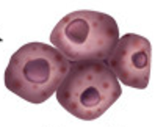
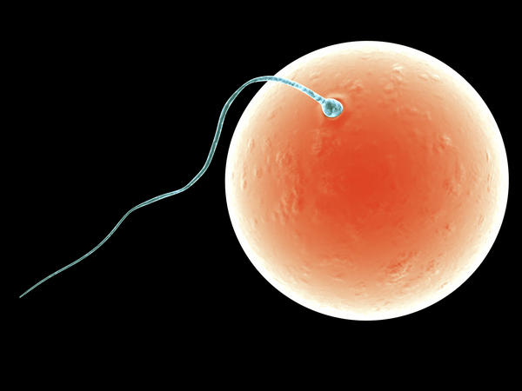
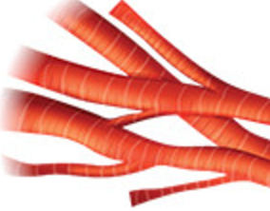
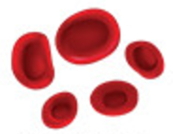
Example biological problem: understanding stem cell differentiation
liver cells
cardiac cells
fertilized egg
blood cells
Cell-types are different because different genes are turned on
How is cell-type-specific gene expression controlled?
Ans: “control elements” act like switches to turn genes on
Notes:
Here’s an example of a problem my lab is very interested in; it’s understanding stem cell differentiation. All cells have v. different sequence, and yet blah blah. That is because a v. different set of genes is turned on in …, so a natural quesiton is how is cell-type specfic gene expression controlled..., answer to that is complicated and many aspects are still a mystery, but one piece of the puzzle is the presence // of what I will just refer to as “control elements” that are accessible in very specific tissues and are what turn on nearby genes. What do I mean by accessible control elements?

Slide 31
Q: Which DNA positions in control elements matter?
Experimentally measure control elements in different tissues
Predict tissue-specific activity of control elements from sequence using deep learning
Interpret the model to learn important positions!
Notes:
In fact, the majority of disease associated mutations…this is because if I mutate the binding site of one of these controller proteins...so a natural question is...because not all of the positions are important...by contrast if you mutate a base within a gene, unless the amino acid is kept the same...
How can we answer this question using a combination of biology and machine learning techniques...these are where the labels for our machine learning come from.

Slide 32
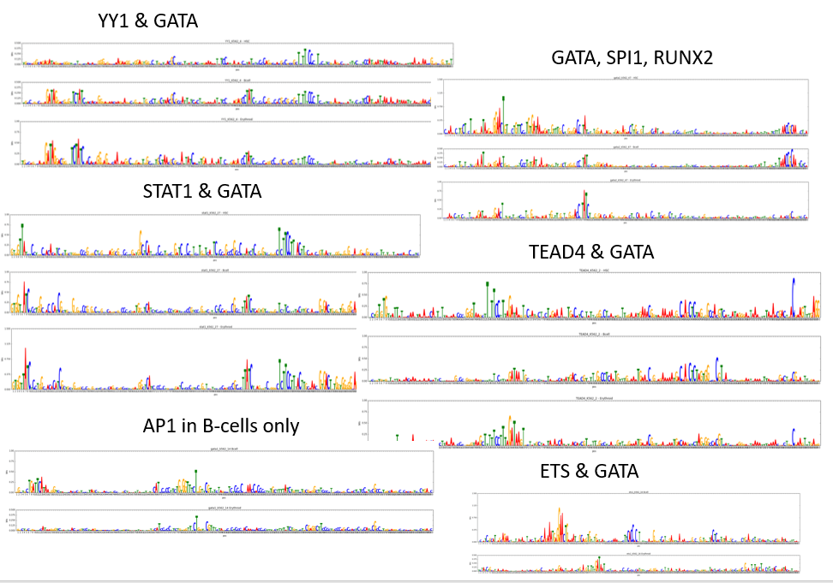
Can study the regulatory code in millions of control elements!
Peyton Greenside

Slide 33
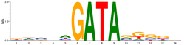
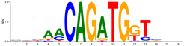

In development: Discover dependencies with “Delta DeepLIFT”
Peyton Greenside
(“Gata” pattern)
(“Tal” pattern)
Simulation: random background sequence with
0-2
0-2
Positive set: at least one
and at least one
Identify sequences with one
and one
Mutate the

Slide 34
The DeepLIFT solution: consider different orders for adding positive and negative terms
i₁ = 10, i₂ = 6
y = i₁ – ReLU(i₁ – i₂)
= 10 – ReLU(4) = 6
← min(i₁=10, i₂=6)
Standard breakdown: y = 6 = (10 from i₁) – [(10 from i₁) – (6 from i₂)] = 6 from i₂
Average over both orders: y = 6 = (10 from i₁) – [(7 from i₁) + (-3 from i₂)]
= (3 from i₁) + (3 from i₂)
Standard breakdown:
4 = (10 from i₁) + (-6 from i₂)
Other possible breakdown:
4 = (4 from i₁) + (0 from i₂)
Average i₁ & i₂ contributions:
4 = (7 from i₁) + (-3 from i₂)
ReLU(i₁ - i₂)
ReLU(i₁ - i₂)
> 2 inputs: club pos & neg inputs into 2 “meta” terms, assign importance, distribute proportionally
-6
+10
4
4
0
+4
i₁ - i₂
i₁ - i₂
4
4
i₁=10
i₂=6
“A unified approach to interpreting model predictions” - Lundberg & Lee
i₂=6
i₁=10

